Slide 1
Food Waste
Management System
“Reduce Food Waste • Help People in Need”

Slide 2
Presented by :
Names Roll Number
G. ISAAC DANIEL 2500031202
S. ABHISHEK REDDY 2500031276
M. MADHUSUDHAN REDDY 2500031523
.

Slide 3
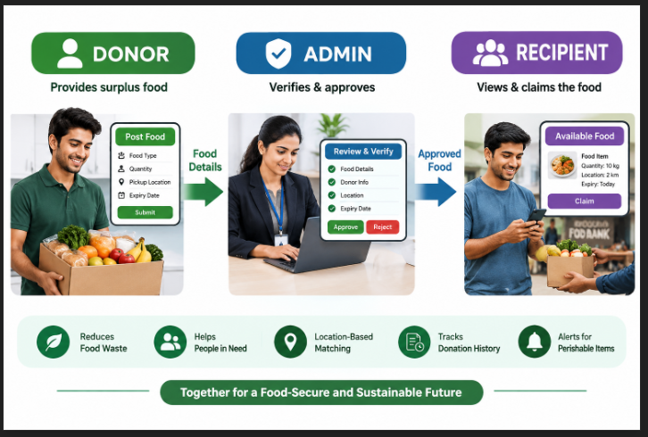
Problem Statement
Food is wasted when there is extra or surplus food.
Donors can share details about the extra food.
Charities or food banks can receive the donated food.
Recipients can view and claim the available food.
Location matching helps find nearby food and recipients.
The system tracks donation history for better management.

Slide 4
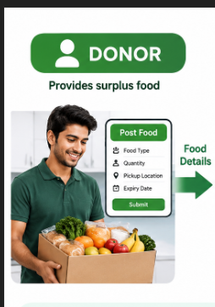
Donor Module
Provides surplus or extra food that would otherwise be wasted.
Enters food name, quantity, pickup location, and expiry date/time.
Submits the food information to the Admin for verification.
Can check the status of the submitted food.
Helps connect usable food with people who need it.
Contributes to reducing food waste and promoting food sharing.

Slide 5
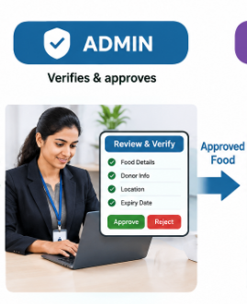
Admin Module
Manages all food donations submitted by donors.
Reviews the food details and verifies or rejects each submission.
Changes verified food status to Available for recipients.
Monitors donation details and food claims.
Keeps track of donor and recipient information.
Ensures proper coordination between the Donor and Recipient.

Slide 6
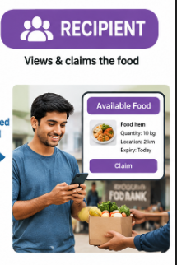
Recipient Module
Views verified and available food through the system.
Provides name, phone number, and location before claiming food.
Selects and claims suitable available food.
Can view the food quantity, pickup location, and expiry details.
Can view their claimed food and claim status.
Helps ensure surplus food reaches people or organizations in need.

Slide 7
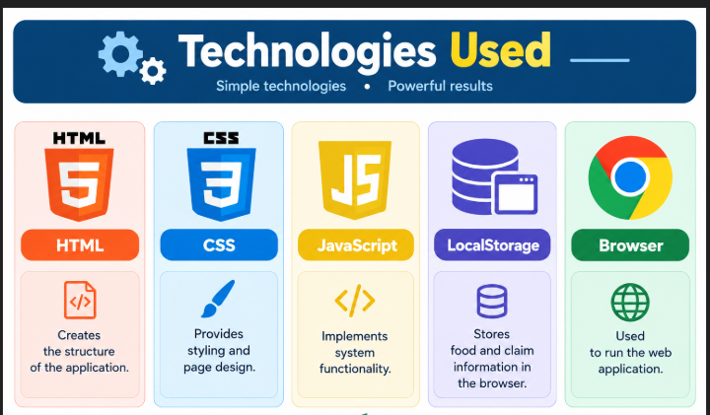
Technologies Used
HTML
  Creates the structure of the application.
CSS
  Provides styling and page design.
JavaScript
  Implements system functionality.
LocalStorage
  Stores food and claim information in the browser.
Browser
  Used to run the web application.

Slide 8
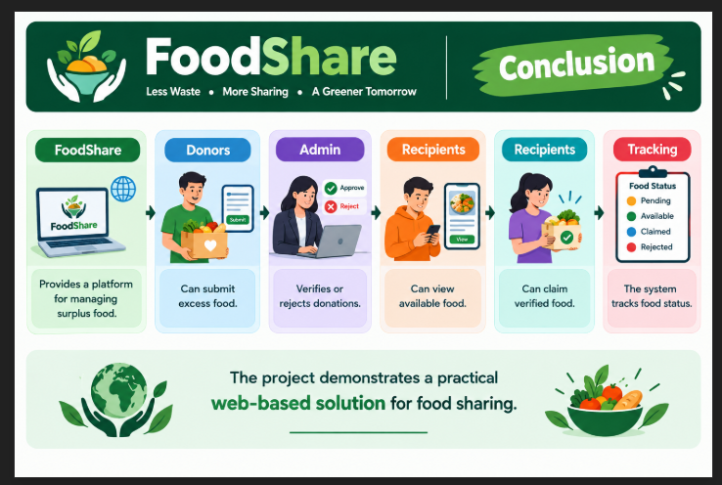
Conclusion
FoodShare provides a platform for managing surplus food.
Donors can submit excess food.
Admin verifies or rejects donations.
Recipients can view available food.
Recipients can claim verified food.
The system tracks food status.
The project demonstrates a practical web-based solution for food sharing.

Slide 9

THANK YOU
.

